Slide 1
Model – View - View Model Brief Intro
By : Suraj Kulkarni

Slide 2
Project analysis slide 2
Content
Android Architecture
Components
1
Actual Code
3
MVVM
MVVM Overview
Q & A
2
4
Notes:
Android Architecture Components : Android JetPack (May 2018) – Foundation, Architecture, Behavior, UI. – To make android development easier and seamless. Here we will discuss important Architecture components and how they work together. Will tell you about android JetPack Libraries.
MVVM Overview : In this section I will give you a over view kind of block diagram as to how things work in MVVM.
Low-level Programming : In this section I will demonstrate the actual code how it works with the help of out Krios Champs Application.
Q & A : This section is for all of you. I will try to answer your queries else will get back to you.

Slide 3

Android JetPack
Foundation
Architecture
Behaviour
UI
Data Binding
LifeCycle
LiveData
Navigation
Paging
Room
ViewModel
WorkManager

Slide 4



Project analysis slide 3
Android Architecture
Components
Lifecycle Aware Components
LiveData
ViewModel
Room
DataBinding
LiveData is an observable data holder class. Unlike a regular observable, LiveData is lifecycle-aware, meaning it respects the lifecycle of other app components, such as activities, fragments, or services.
The ViewModel class is designed to store and manage UI-related data in a lifecycle conscious way. The ViewModel class allows data to survive configuration changes such as screen rotations.
The Data Binding Library is a support library that allows you to bind UI components in your layouts to data sources in your app using a declarative format rather than programmatically.
The Room persistence library provides an abstraction layer over SQLite to allow for more robust database access while harnessing the full power of SQLite.
Lifecycle-aware components perform actions in response to a change in the lifecycle status of another component, such as activities and fragments.
Notes:
Need of Architecture?
Separation of concerns
Separate Business Logic from UI
Drive UI from a model
Available Architectures : MVC, MVP, MVVM
Why MVVM?
Lifecycle Aware Components : To reduce the amount of code present in Lifecycle Activity Methods./ make code more organise/ reduce chances of application errors and crashes. Avoid Race condition. Avoid memory leaks.
Live Data : Ensures your UI matches your data state * No memory leaks * No crashes due to stopped activities * No more manual lifecycle handling * Always up to date data * Proper configuration changes * Sharing resources

Slide 5
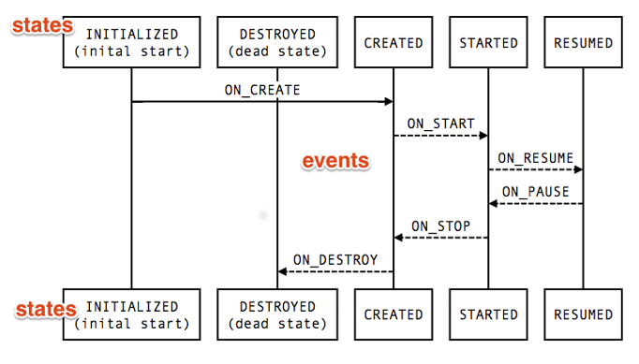
Project analysis slide 4
Lifecycle Aware
Components
Sr.No | Steps
1. | Add Dependencies
2. | Create Observable Class and extend with LifeCycleObserver class
3. | Get LifecycleOwner instance from constructor and add observer
4. | Pass instance of lifecycle owner from Activity by calling constructor of Observable Class
5. | Start Writing Annotations for Events and get state of activity.
Click here for Use Cases

Slide 6
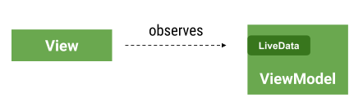
Project analysis slide 4
Live Data
Notes:
Simple lifecycle aware Observable dataholder.
When the value of livedata is changed onChanged is automatically called in UI component.
LiveData is only observable when UI Component’s LifeCycle is in good State.
LiveData is a dataholder. It holds the data even if its UI component is not visible. It always provides most updated value.
LiveData
Mutable LiveData (set/post)
MediatorLiveData
Transformations : map, switchmap

Slide 7
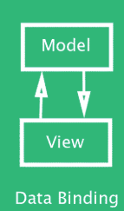
Project analysis slide 6
Data Binding
Sr. No. | Steps
1. | Enable DataBinding in build.gradle file
2. | Make root tag of layout file as <layout>
3. | Write insert <variable> in<data> tag
4. | Write expressions using @{} syntax
5. | Bind Activity to this layout file
6. | Set Model to layout
Notes:
1. Null coalescing operator
The null coalescing operator (??) chooses the left operand if it isn't null or the right if the former is null.
You can use Operators in the expressions
Automatically checks null values
Handles Events
You can import required classes using <import>
Bind layout views to Architecture Components : - binding.setLifecycleOwner(this);
To Explore : BindingAdapters, BindingMethod, TargetAPI, BindingConversion, TwoWayBinding

Slide 8
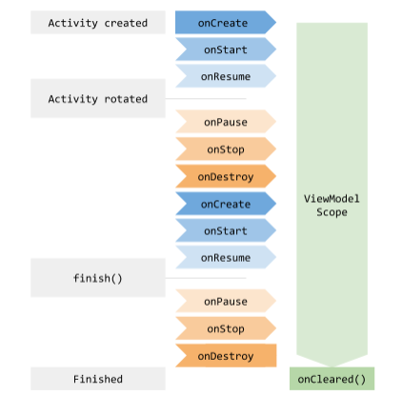
Project analysis slide 5
ViewModel
Sr. No. | Steps
1. | Create a View Model Class and extend with either AndroidViewModel or ViewModel
2. | From Activity create object of ViewModel Class and instantiate using ViewModelProviders.of(this).get(UserListViewModel.class);
3. | Publish LiveData from Viewmodel Class and observe it in UI component.
4. | Call (dot).observe method on liveData object and override onChanged method in UI component to update UI
Notes:
ViewModel is used to persist UI realted data throughout the lifecycle of UI component.
onSavedInstanceState can only handel small amount of data on configuration change and cannot handle large data.
ViewModel Class and Android ViewModel Class.
ViewModel can be shared by fragments.
Never pass context/reference of UI component to ViewModel whereas UI component observes viewModel.
Injecting dependencies into viewModel using Factory

Slide 9
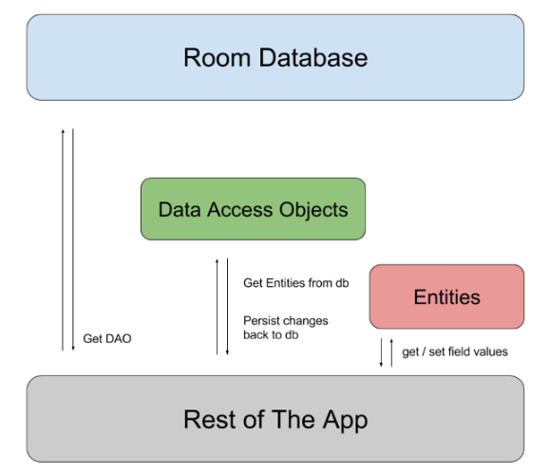
Project analysis slide 6
Room
Sr. No. | Steps
1. | Add Dependencies
1. | Create public Abstract Class and extend RoomDatabase and annotate with @Database
2. | Create Entity Class for each table with fields and getter/setter methods and constructor. Annotate with @Entity
3. | Create Dao interface annotate with @Dao, write database operations here. Annotate each method with suitable operation
4. | Write abstract method in database class which returns Dao object.
5. | Call this method on Database instance and then call Dao methods.
Notes:
In Abstract class you will write migration strategy.
In Entity there must be at least one Primary key.
Getter methods as compulsory in entity.
Room Database can return LiveData objects.
You can use @Ignore annotation if you do not want a field to insert in DB.
Use @TypeConvertor to convert datatypes
Need to call all Dao methods on Background Thread.
Every Select method should return Primary key column

Slide 10
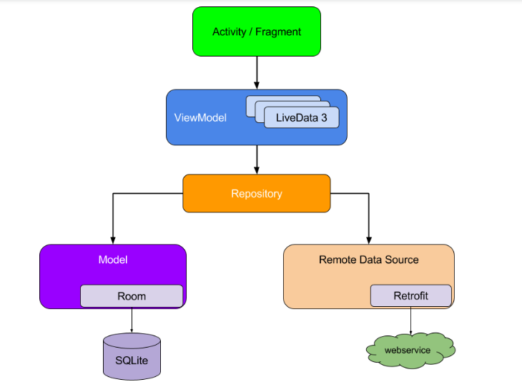
Project analysis slide 6
MVVM Overview

Slide 11

Project analysis slide 10
Q & A

Slide 12
Project analysis slide 10
References
Sr. No. | Concept | Link
1 | JetPack | https://developer.android.com/jetpack
2 | Room Demo | https://codelabs.developers.google.com/codelabs/android-room-with-a-view/index.html?index=..%2F..index#0
3 | DataBinding Demo | https://codelabs.developers.google.com/codelabs/android-databinding/index.html?index=..%2F..index#0
4 | ViewModel, LifeCycle, LiveData Demo | https://codelabs.developers.google.com/codelabs/android-lifecycles/index.html?index=..%2F..index#0
5 | My Demo (SK) | https://github.com/the-kool-sk/AndroidArchitectureComponents_Demo.git
6 | MVVM guide | https://developer.android.com/jetpack/docs/guide

Slide 13
Thank You

